Slide 1
Typing Speed Tester
by Badhma Rohit R.S

Slide 2
Agenda
Introduction
Objectives and Scope of the Project
Flowchart
Project implementation
References

Slide 3
Introduction
In the digital age, typing speed is an essential skill that greatly impacts productivity and communication efficiency. The increasing reliance on technology demands not only proficiency in typing but also the ability to type quickly and accurately.
This project aims to develop a Typing Speed Tester application using Python, which will allow users to assess and improve their typing skills through engaging and interactive practice sessions.
the application will provide immediate feedback on performance. Additionally, users will receive insights into their accuracy and areas for improvement.

Slide 4



Objectives and scope of the project
The primary objective of this project is to design and implement a fully functional typing speed tester
Key objectives of this project include:
Assess Typing Speed: measures users' typing speeds in words per minute (WPM)
User Engagement: Create an interactive and user-friendly interface, making the learning process enjoyable.
Responsive Design: accessible across different devices (desktop, tablet, mobile) for maximum usability.

Slide 5
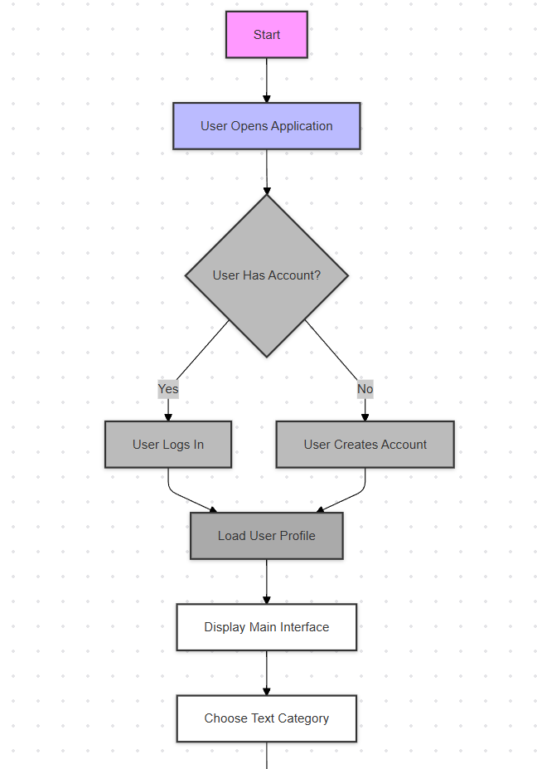
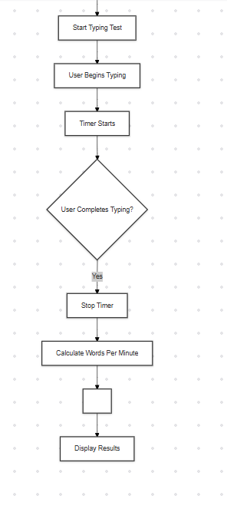
Flowchart

Slide 6
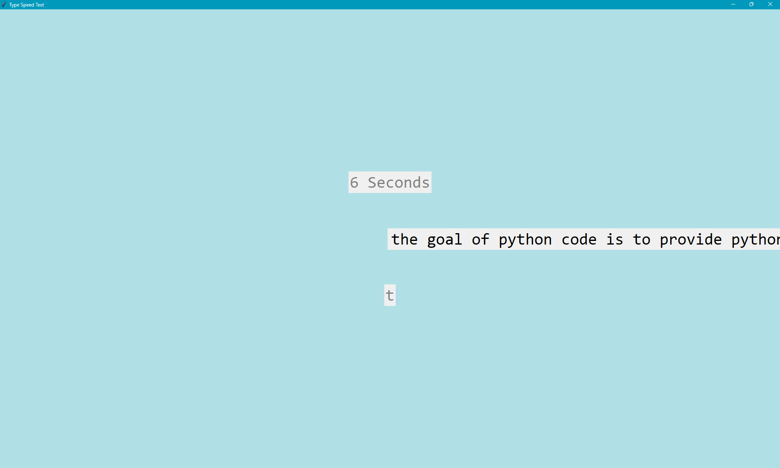
Project implementation
P
R
O
J
E
C
T
I
M
P
L
E
M
E
N
T
A
T
I
O
N

Slide 7
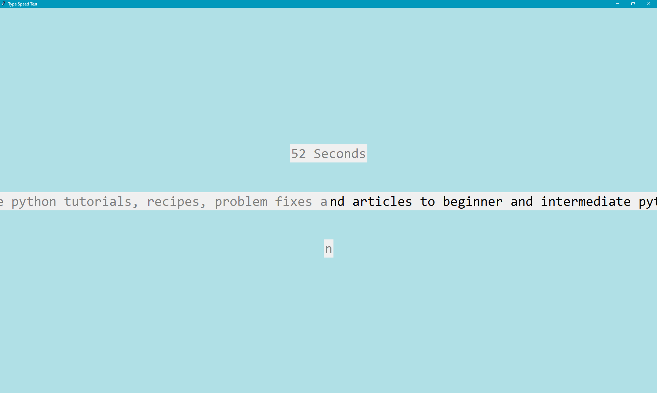
Effective delivery techniques
This is a powerful tool in public speaking. It involves varying pitch, tone, and volume to convey emotion, emphasize points, and maintain interest:
Pitch variation
Tone inflection
Volume control
Effective body language enhances your message, making it more impactful and memorable:
Meaningful eye contact
Purposeful gestures
Maintain good posture
Control your expressions

Slide 8
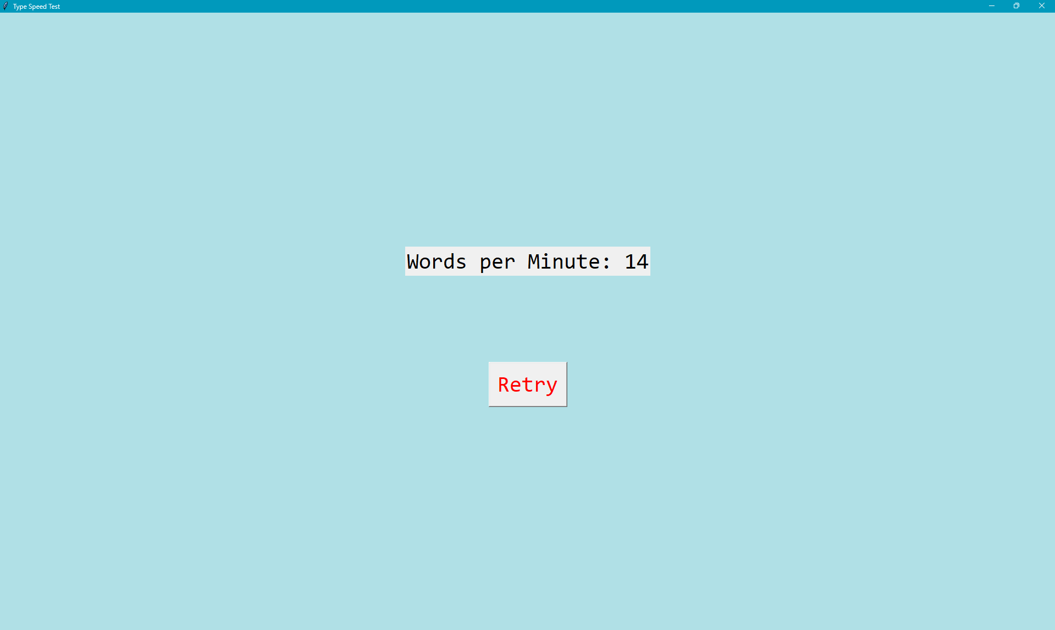
Navigating Q&A sessions
Know your material in advance
Anticipate common questions
Rehearse your responses
Maintaining composure during the Q&A session is essential for projecting confidence and authority. Consider the following tips for staying composed:
Stay calm
Actively listen
Pause and reflect
Maintain eye contact

Slide 9
References
Online Resources • Python Programming Documentation: https://docs.python.org/ Pygame Library Documentation: https://www.pygame.org/docs
TutorialsPoint: Python Basics: https://www.tutorialspoint.com/python/index.htm 2. Documentation for Tools/Libraries Pygame Library Documentation: https://www.pygame.org/docs Python Standard Library: https://docs.python.org/3/library/index.html
Other Resources • Documentation
Preparation: Microsoft Word for writing and formatting the project report.

